Slide 1
VI Project Blockbusters
Rodrigo Ferreira, Bruno Assunção

Slide 2
Blockbusters
Our work is based on movies, more specifically blockbusters, films that gain widespread popularity and achieve great financial success.
We chose this topic because it’s something we’re both interested in, making us more motivated to execute it.

Slide 3
Dataset
The dataset we used was found on kaggle at https://www.kaggle.com/narmelan/top-ten-blockbusters-20191977/
It contains 430 entries, each representing a movie, but they weren’t selected randomly, they’re the 10 highest grossing films from 1977-2019.
Each entry has plenty of useful attributes, but the most relevant for our project were each movies’:
Title;
Release year;
Genre and subgenre;
Imdb rating;
Mpaa rating;
Distributor;
Worldwide gross;
Budget;

Slide 4
The target users
Given that our dataset contained so much data regarding such a huge industry, we decided to make our application targetting those interested in investing in its market.
We aim to help possible investors decide on which movie distributors (companies responsible for marketing) to invest in.

Slide 5
Questions
We came up with what we considered to be the most important questions a possible investor faces:
How is the evolution of the movies’ revenue, and what genres are trending at what time?
Which distributor excels at which genres?
How much revenue does each distributor make on average and how does that relate to its average budget (more or less efficient use of money)?
Which genre is the most profitable for each target audience?
We consider that these are relevant questions and their answers can help our user make a more informed decision.

Slide 6
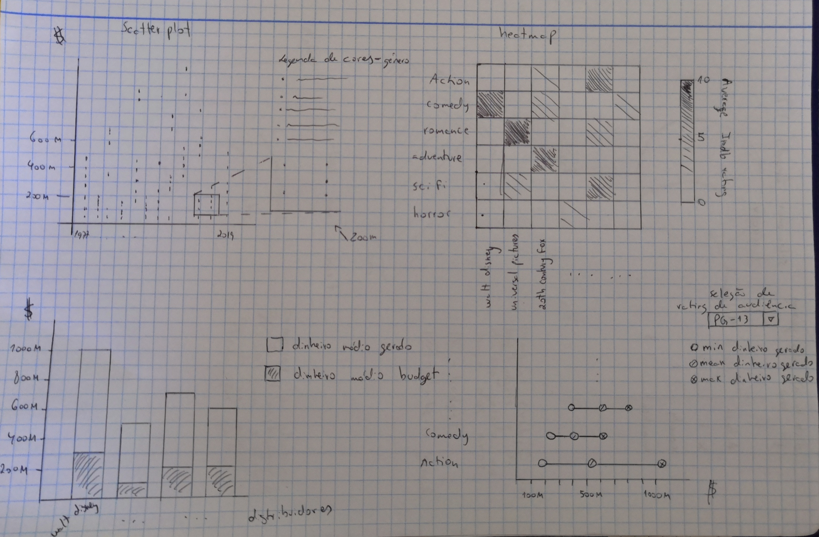
Low fidelity prototypes
Once we had our questions set, we drew a very simple prototype of the application in order to get some feedback.
We will now explain each visualization one by one.

Slide 7
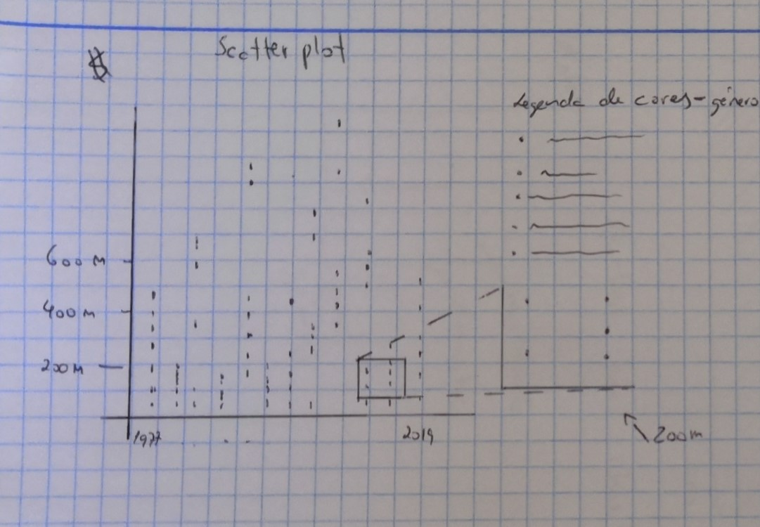
Evaluating revenue trends and genre preferences
We decided that this phenomenon could be well represented with a scatter plot.
Each cell represents a movie, mapped to the x axis using its year and to the y axis using its worldwide gross in millions of dollars. Each cell also has a different color depending on its genre.
There is also a zoom feature represented in the prototype to help visualize spaces where there are a lot of cells cluttered.

Slide 8
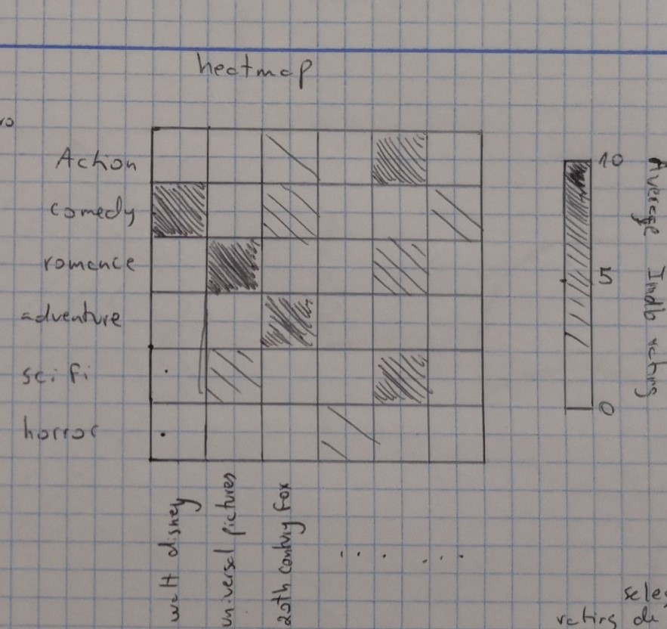
Which distributor excels at which genres?
We picked a heatmap to visualize the average imdb rating for each genre/distributor combination, where the darker the tone, the higher the average rating.
We believe this is a simple way to visualize how good/bad each distributor is at picking the movies they’re responsible for, for the various genres.

Slide 9
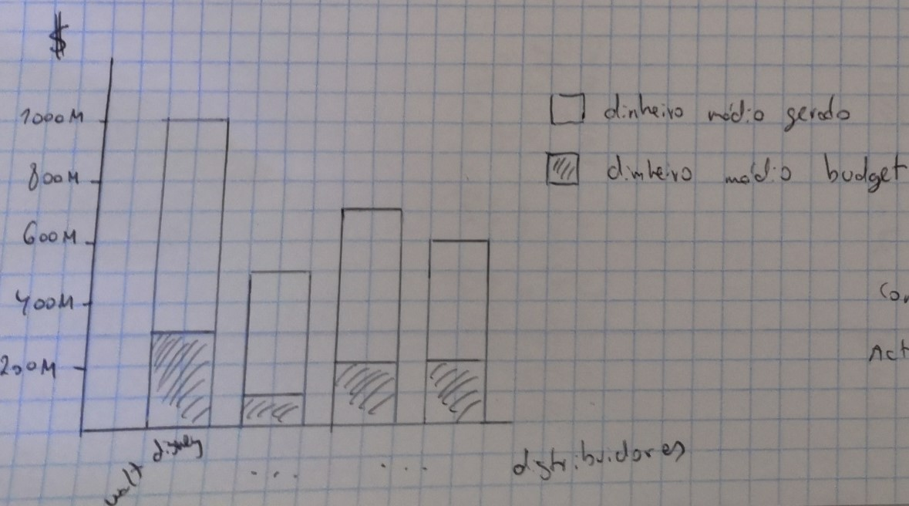
Average revenue, budget and efficient money use
We thought that a stacked bar chart was a good way of comparing each distributor’s average revenue and average budget through the use of 2 bars each, allowing us to get an idea of both values and how they relate.
Bigger differences between a distributor’s gross and budget (where the gross is larger) indicate a more eficiente use of the budget.

Slide 10
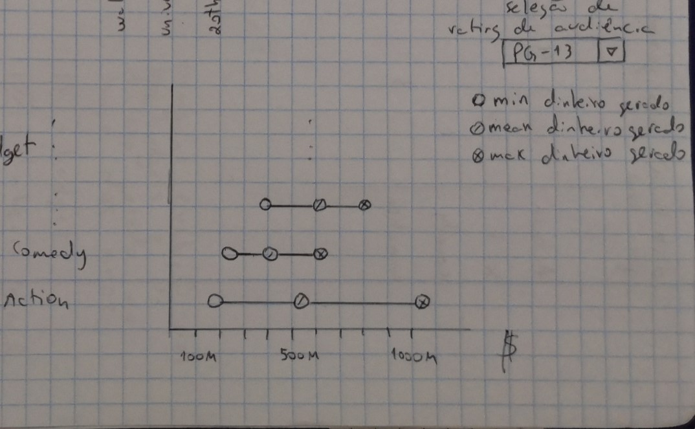
Which genre is most profitable for each target audience
We picked a modification of the lollipop chart called Cleveland dot plot to represent each genre’s minimum, average and maximum revenue for each target audience (selected individually by the user).

Slide 11
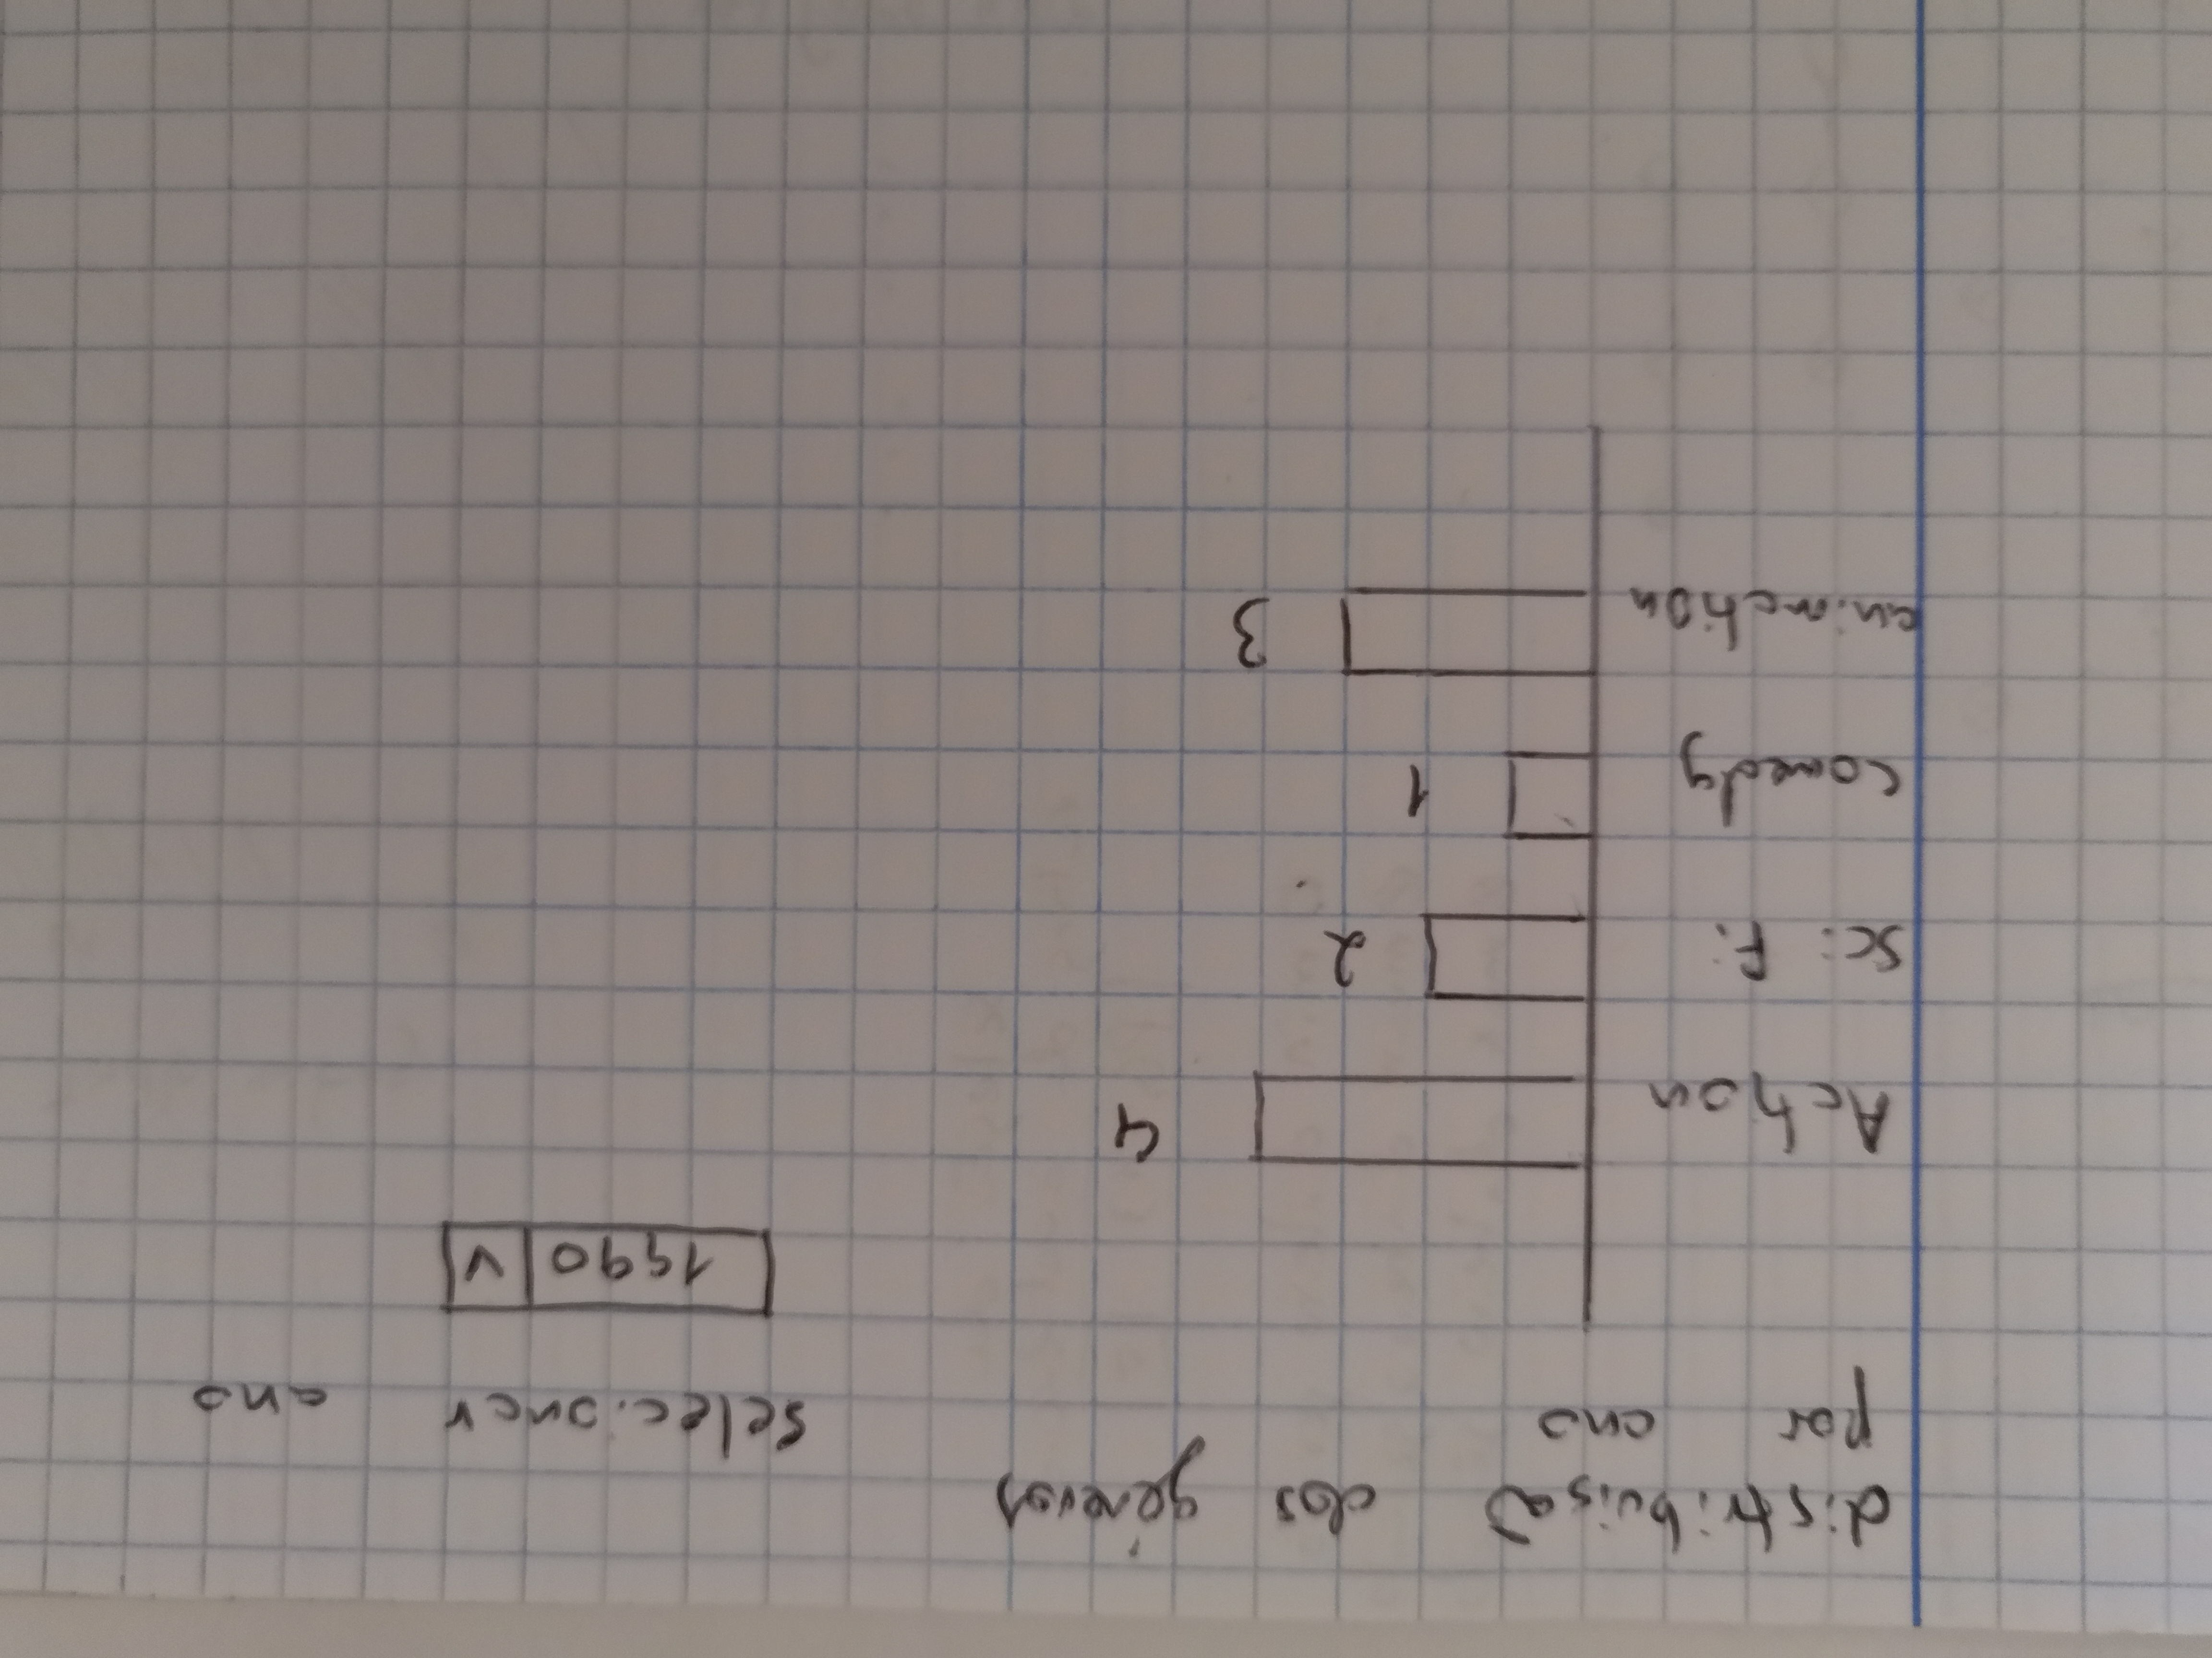
Exploration of the data
Although this isn’t the most useful chart for an investor, we decided to add a bar chart to allow the user to explore the dataset.
The user selects a year and the chart shows the genre distribution of the 10 highest grossing movies of that year.

Slide 12
Feedback
We got some very useful feedback, and the visualizations seemed appropriate but some extra features were suggested, mainly:
The addition of a way to filter out all genres except 1 at once by hovering over the legend on the scatter plot.
The addition of a tooltip both on the heatmap and the stacked bar chart, to clarify the data by showing values (average rating and sample size on heatmap, and budget/gross ratio and sample size on stacked bar chart).
The addition of a simple search box where the user can search for a movie and see its most relevant information.

Slide 13
Functional prototype
We then started implementing with our colleagues’ feedback in consideration.
We made a site containing 4 pages:
Introductory page;
Data exploration page;
Main page for answering the questions we defined;
Page with source information.

Slide 14
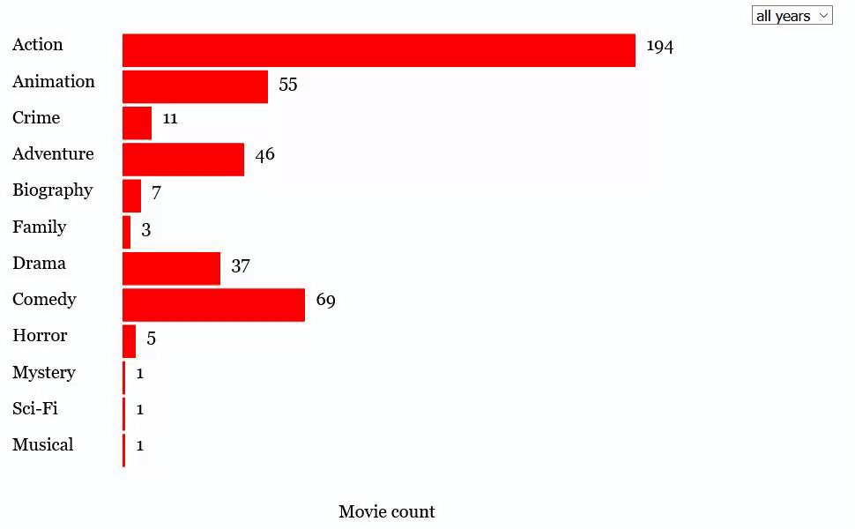
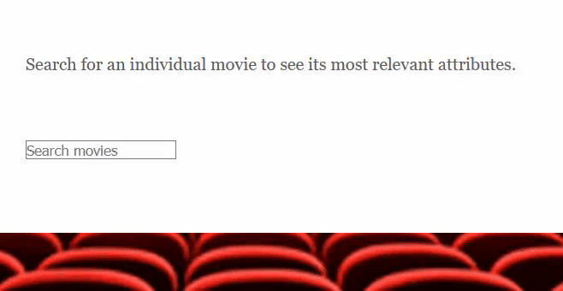
Data exploration page
The data exploration page contains the bar chart showing the distribution of genres for the user selected year, and the movie search box.

Slide 15
Main page
The main page contains the 4 main charts shown in the prototype designed to answer our questions.
We will now show each implementation.

Slide 16
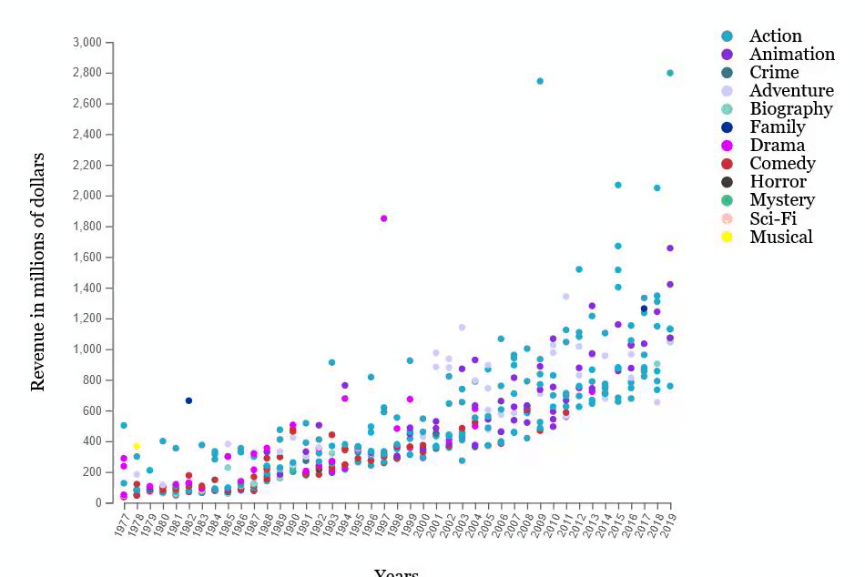
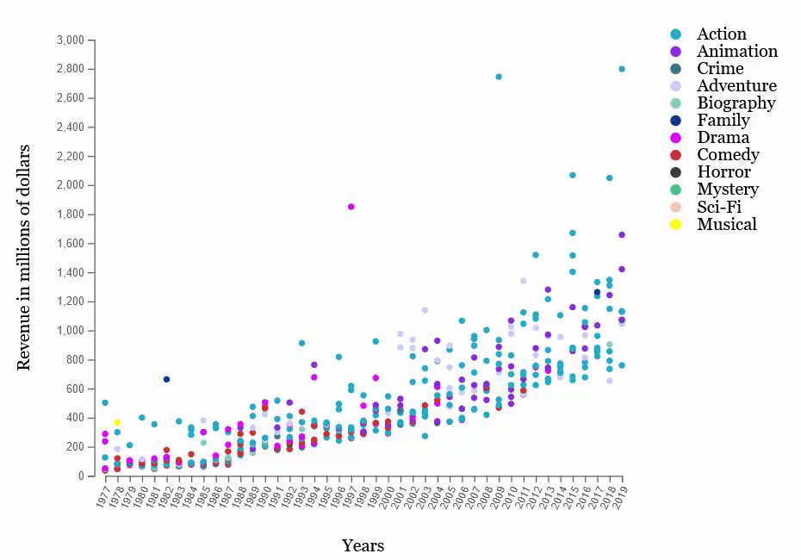
Scatter plot implementation

Slide 17
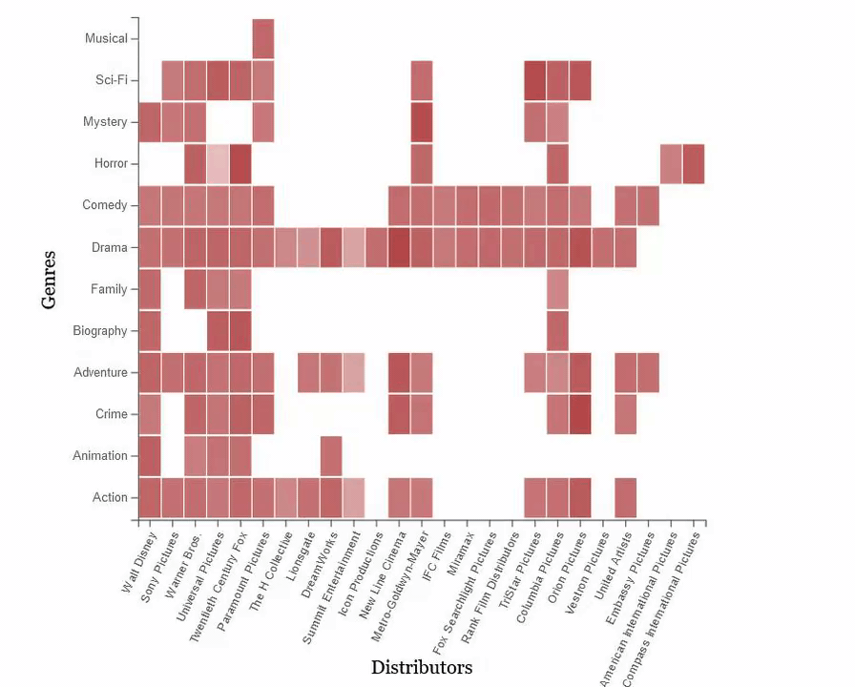
Heatmap implementation

Slide 18
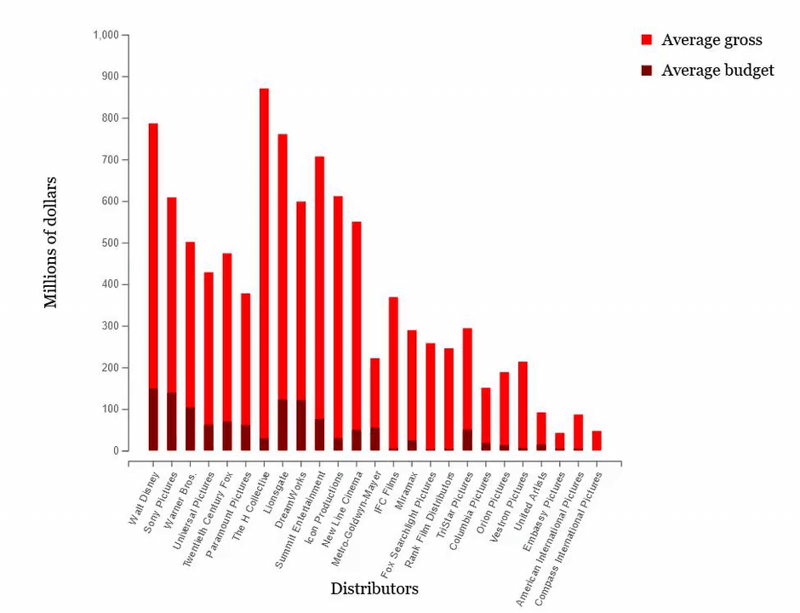
Stacked bar chart implementation

Slide 19
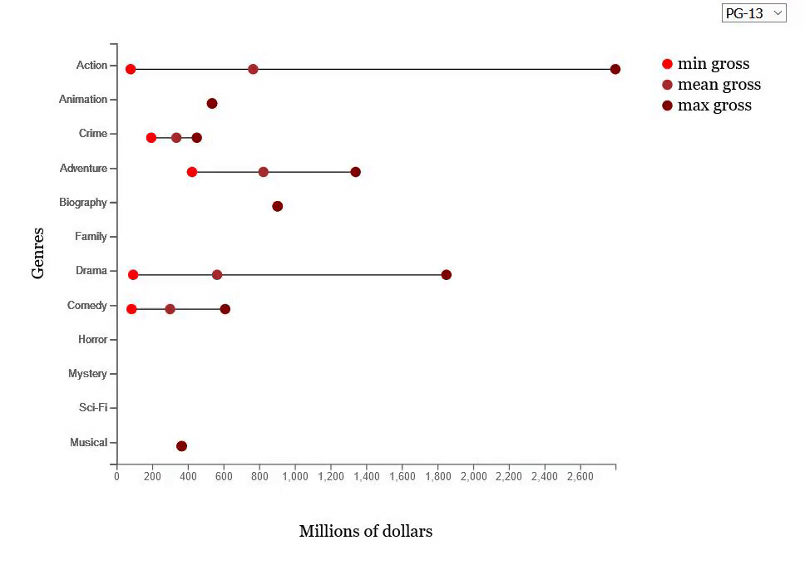
Modified lollipop implementation

Slide 20
New feedback
With our first implementation complete we set out to get new feedback, and so, we asked our colleagues some questions to assess whether they could navigate our app to get the appropriate answers.
Questions such as:
How has the publics preference for the genre comedy changed over time?
Which genre is the distributor Tristar pictures better at?
What is columbia pictures’ average budget and how does it relate to their average revenue?
Which genre has the highest average gross for the mpaa rating “PG”
How many action movies are in the 2019 top 10?

Slide 21
Results
Most of the users could answer the questions effectively though some were more intuitive than others and so, we didn’t make any major changes and proceeded to just polish the application to its final state.

